Slide 1



OOPS
PROJECT
HOSPITAL MANAGEMENT SYSTEM

Slide 2

OVERVIEW
01
02
03
Our Team
Description
Classes
04
05
06
Transactions
Individual Contribution
Future Scope

Slide 3



OUR TEAM
Ashutosh Mishra (122CS0032)
Ayush Mishra (122CS0072)
Harsh Shrivastava (122CS0014)
Ravi Shankar Yadav (122CS0058)

Slide 4





DESCRIPTION
01
The HMS typically comprises modules for doctors management, patient management, medical record keeping, billing, and bed availability.
02
Each module is encapsulated with its own data and functionality, promoting code reusability and facilitating easier debugging and maintenance.

Slide 5

CLASSES
Password
For securing Hospital Management System , password protection is required.
For storing and manipulating doctor’s information
Doctor
For storing and manipulating patient’s information and checking for availability of doctors of specific type.
Patient
For checking availability of bed in hospital
Bed

Slide 6

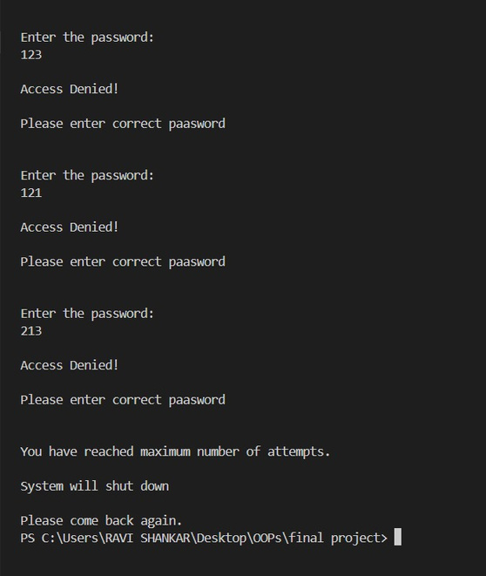
PASSWORD PROTECTION
01
While , entering into hospital database a password is created.
02
For doing a transactions each time password is required to enter into a database . If wrong password is entered thrice code is exited

Slide 7
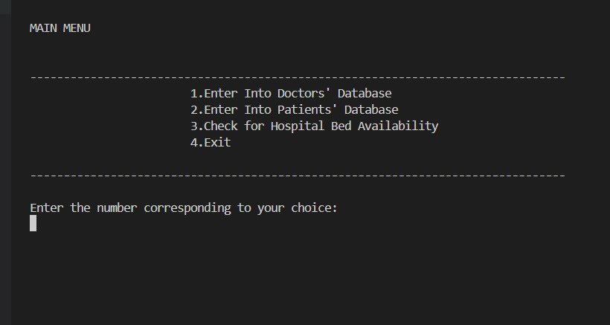


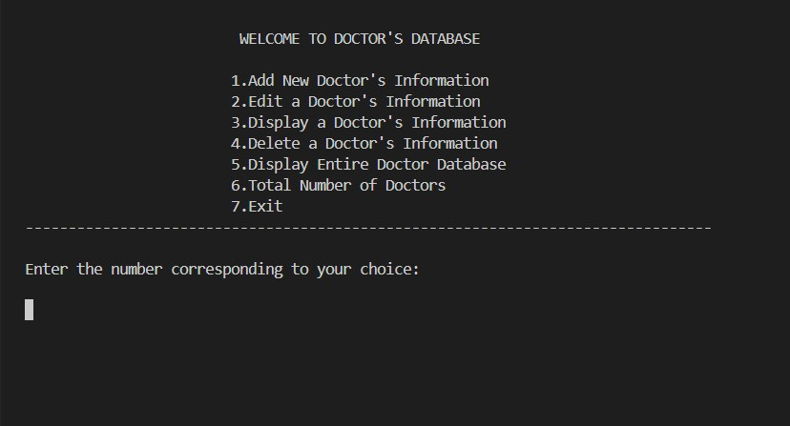
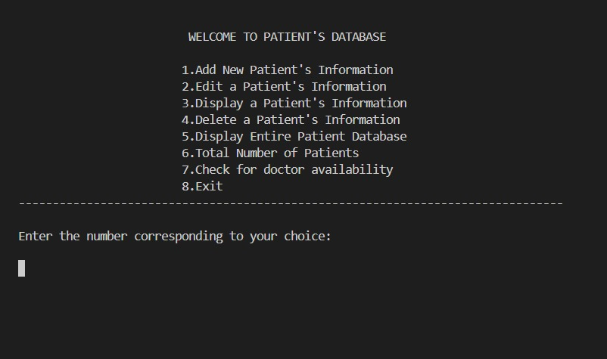
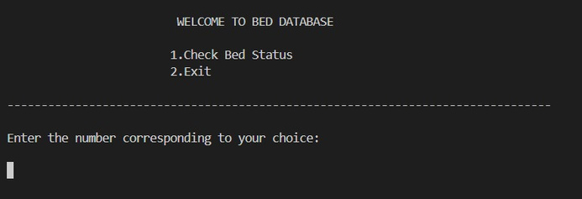
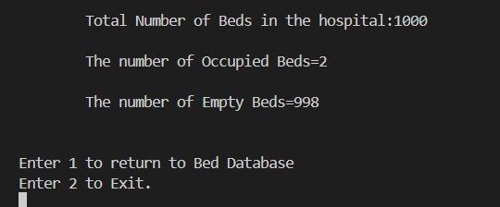
TRANSACTIONS
Hospital Management System
getDoctorDatabase()
getPatientDatabase()
getBedDatabase()

Slide 8
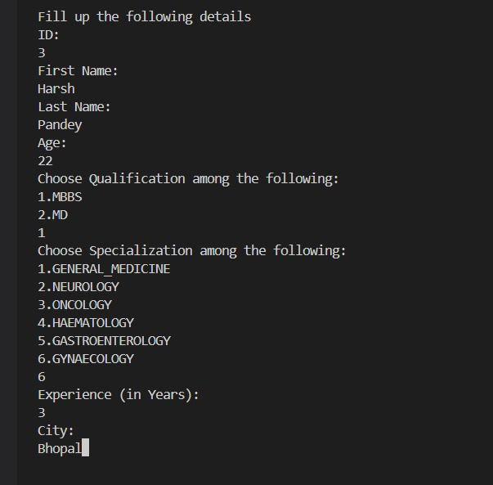
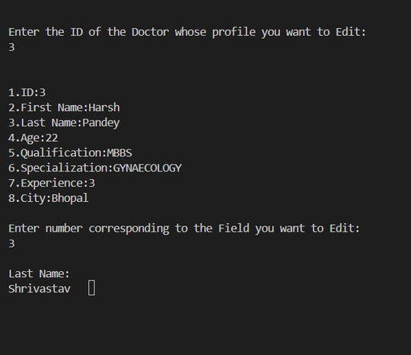
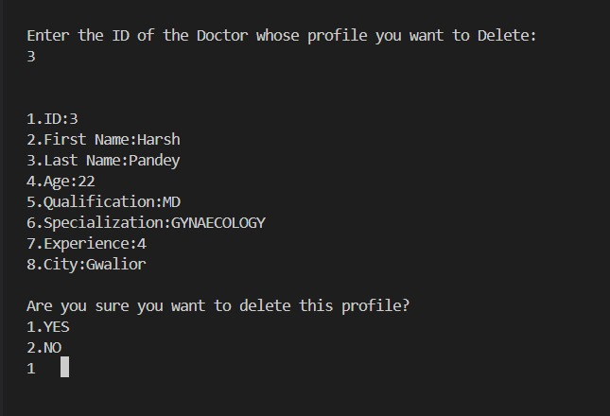
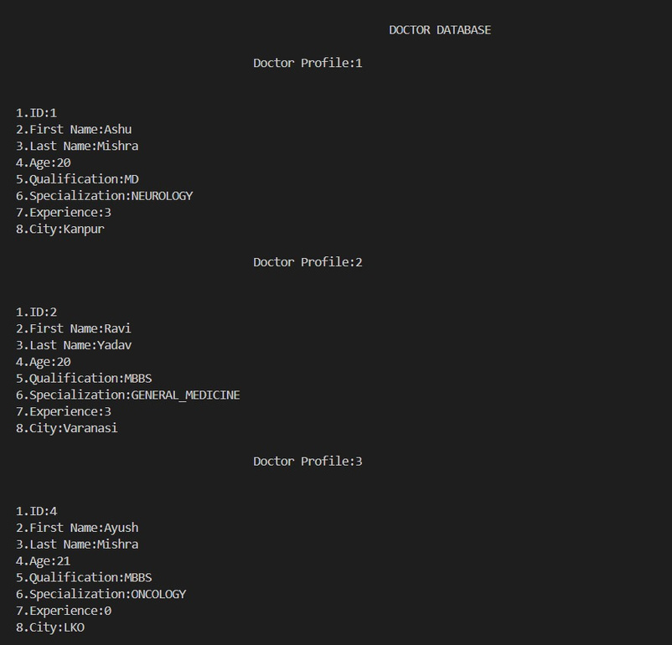
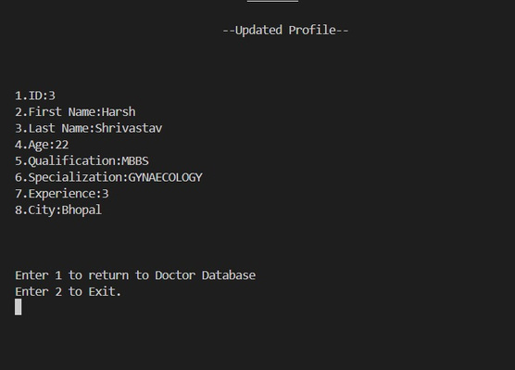
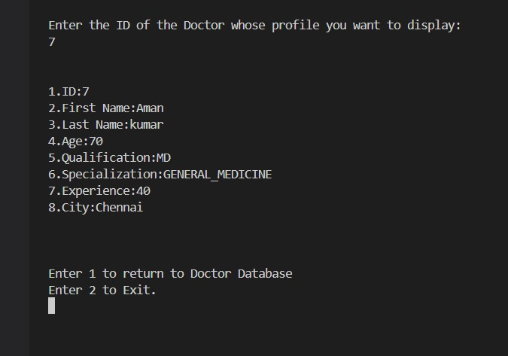
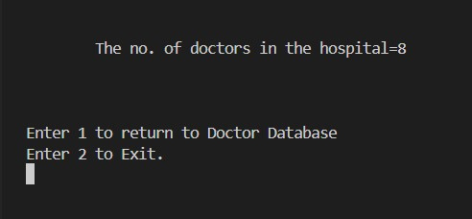
getDoctorDatabase()
addDoc()
editDoc()
deleteDoc()
displayDocDatabase()
displayDoc()
numberOfDoc()

Slide 9
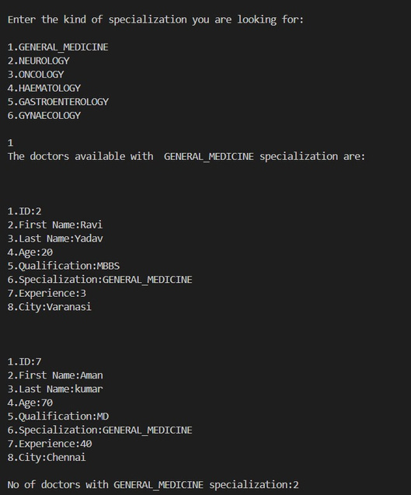
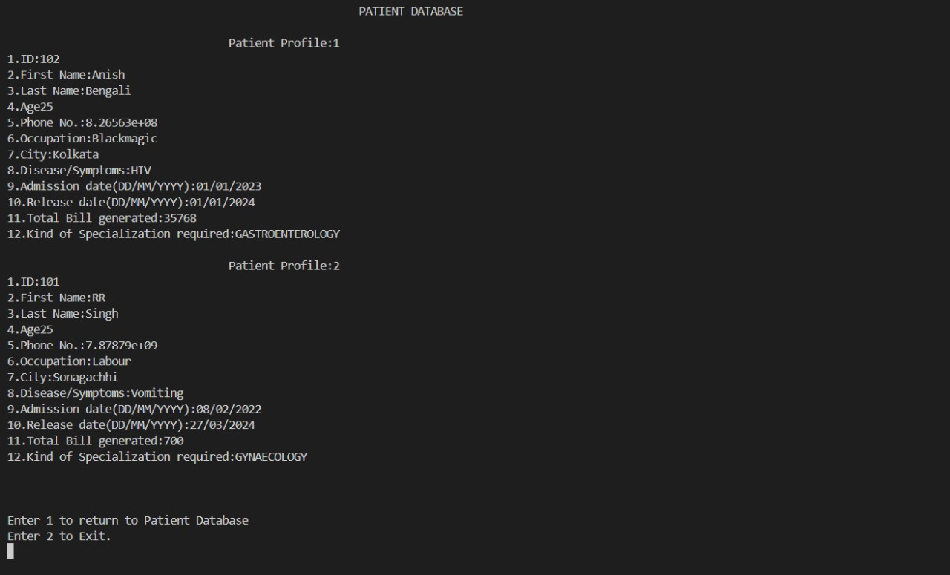
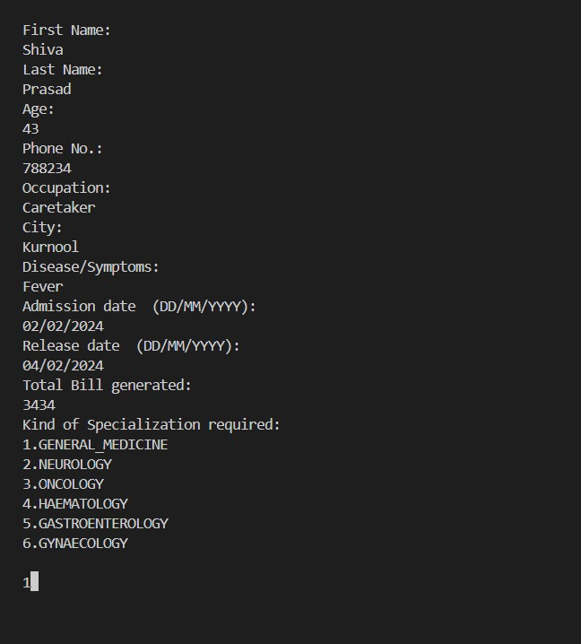
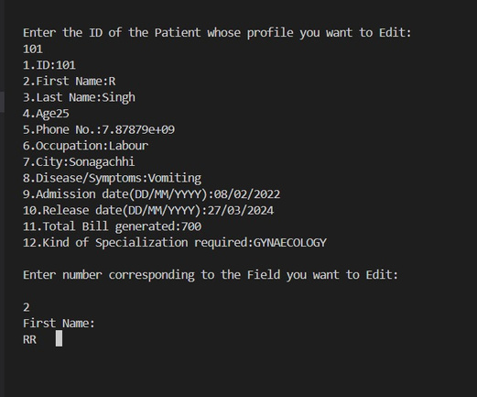
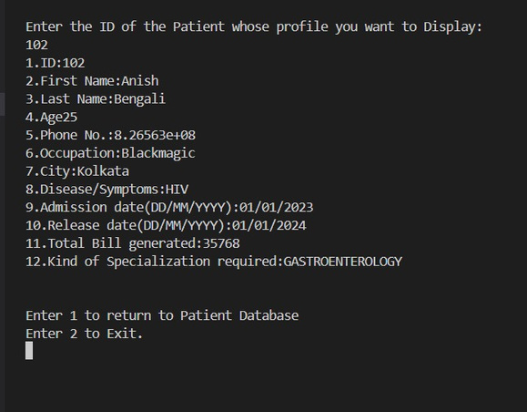
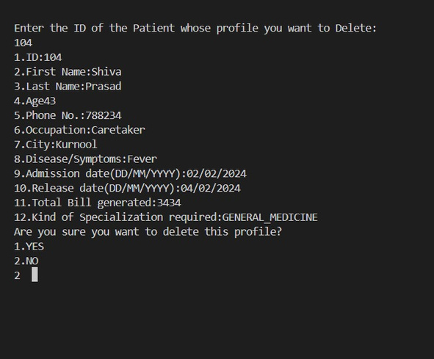
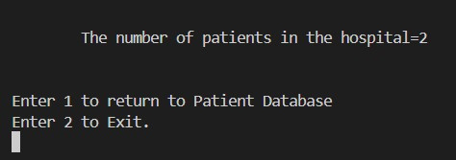
getDoctor()
getPatientDatabase()
displayPatDatabase()
addPat()
editPat()
displayPat()
deletePat()
numberOfPat()

Slide 10



INDIVIDUAL CONTRIBUTION
Doctor
Patient
Merging
Doctors class is implemented by Ashutosh and Ravi
Patient class is implemented by Ayush and Harsh
Together we merged all code and designed some other transactions

Slide 11

FUTURE SCOPE
IMPLEMENTATION
This project have potential to be Implemented in a hospital
Improvements
The project can be improved by addition of several new classes like ambulance , medicine information etc .

Slide 12


Thank's For Listening

